Slide 1
Compliance Management Information System
Administrative
Non-Compliance
Management Training
Dax Bourke
A/Executive Director C&E
CM-IS Product Owner

Slide 2
Agenda
Introduction
CM-IS Background
System Training
Questions
Notes:
Understand there is a lot of information to be passed on.
Recording presentation and it will be made available
Sharing and posting a user guide
Use the chat for any questions and I will answer at the end

Slide 3
Compliance Management Information System
An information system for managing inspections, non-compliance and enforcement
Includes an industry portal for communicating compliance information
This release will introduce the capability to issue administrative non-compliance notices to permit holders, and to manage the resolution process.
Future releases will add the capability to receive and manage non-compliance notices from inspections, and a portal to provide additional data to help industry proactively manage compliance.

Slide 4
Compliance Management Information System
Provide a more consistent process for staff and industry to manage non-compliance
Collect data about compliance to provide industry with a clearer picture of their compliance performance, and to enable the commission to identify and target compliance patterns and trends
Maintain a complete and reliable record of compliance efforts
Notes:
Why we are implementing

Slide 5
Compliance Management Information System
Enables the Commission to document and issue non-compliance notices
Notifies permit holders and their representatives via email when a non-compliance notice is issued, when Commission staff respond, when it becomes overdue, and when it has been resolved
Provides an online portal for industry to track and respond, request extensions and request additional clarification
But… CM-IS is not a system for uploading submission requirements – you must continue to use existing processes for that (i.e. eSubmission, email etc).
Notes:
CM-IS is a simple but powerful tool for managing compliance. It does three main things. It is important to note that you still have to provide operational submissions via eSubmission, email or whatever means it is required.

Slide 6
Terminology
Old Term | New Term
Administrative Deficiency | Administrative Non-compliance
Notice Type | Discovery Method
Rank: Low 14, Low 30, High | Correction Duration: 14 or 30 Days, 24 hours
Notes:
We’ve changed a few key terms with the implementation of this system.

Slide 7
Managing Access to CM-IS
CM-IS uses the same Online Systems account as most other Commission Information Systems
Users require the “Admin Deficiency Representative” role to be assigned by their company administrator
System notifications are sent to everyone with this role. If no one at the company has this role, the notification will be sent to the company administrator, or barring that, to the main company contact.
Notes:
It is important that you set up the correct security roles so that they right people get notified, and so that people who shouldn’t be getting these notifications do not.
(although when the CM-IS goes live we will change the name of the role to “Admin Non-Compliance Representative” for consistency)

Slide 8
Non-Compliance Notice Overview
Notes:
A Non-Compliance Notice includes one or more individual Non-Compliances that were discovered at the same time. Non-Compliances are the lowest tier on the Commission’s graduated Enforcement Model. They document an observed Non-Compliance and provide an opportunity for correction within a set timeline.
Non-Compliance Notices are not intended to replace the Permit Holder’s responsibility of identifying and maintaining legislative compliance within their operational requirements. Permit Holders are expected to understand and manage their compliance on a regular basis.
The Non-Compliance Notice process includes the following basic steps:
The Permit Holder will receive a Non-Compliance Notice, listing one or more Non-Compliances, via email and then they will access the CM-IS Permit Holder Application.
If needed, the Permit Holder submits a Request for Clarification Submission or a Request for Extension Submission
The Permit Holder corrects the Non-Compliance and then, depending on the nature of the Non-Compliance, submits the required documentation via the appropriate process and system, such as KERMIT, eSubmission, Petrinex, or via a specified email account. Submitting these documents via CM-IS will not resolve the Non-Compliance.
The Permit Holder submits a Respond to Non-Compliance Submission in CM-IS, indicating how the requirement has been met.
The Commission reviews the Permit Holder’s Respond to Non-Compliance Submission and either accepts it or requests more information. The Commission may also retract the Non-Compliance if it was issued in error or if the Permit Holder has received an exemption.

Slide 9
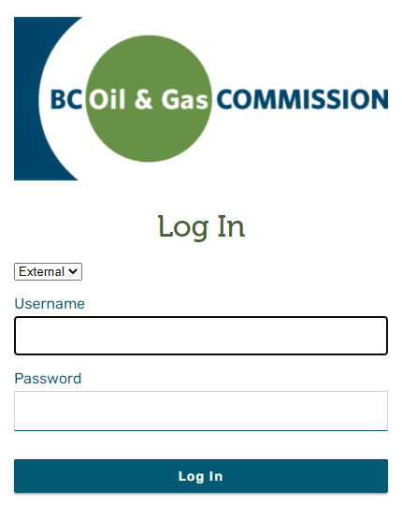
Log In & Out
Notes:
From your workstation’s desktop, start either the Google Chrome or Microsoft Edge web browser (no other web browsers are supported, at this time).
To Log In
Enter the external username provided by the Commission
Enter the corresponding password
Select Log In

Slide 10
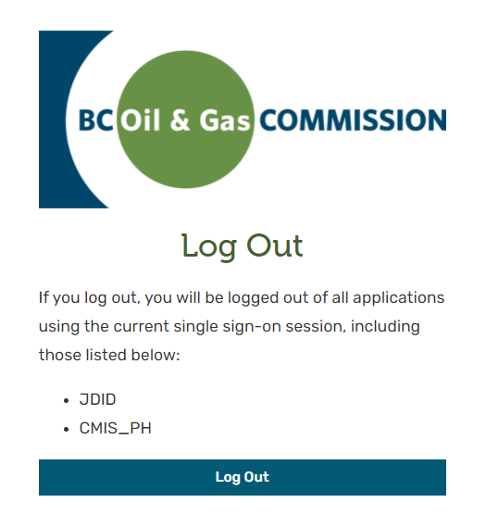
Log In & Out
Notes:
To log out of CM-IS:
Select the User Profile Icon
Select the Log Out option
Click on Log Out
The timeout period for the application is 10 hours. If the application has been idle for 10 hours, with the user still logged in, the system will log the user out of the application.

Slide 11
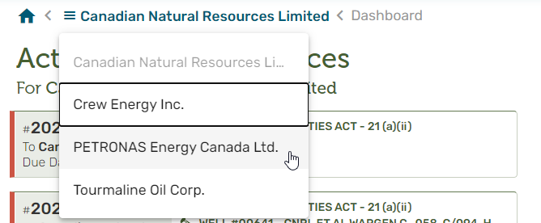
Selecting an Organization
Notes:
Once logged into CM-IS, the ‘Administrative Non-Compliance Representative’ will be able to view a list of all Organizations they represent.
If the user only has access to one Organization, CM-IS will automatically default to this Organization and the user won’t be able to select or change their Organization.
At any time while logged into CM-IS, switch between Organizations by clicking on the bread crumb at the top of the page and select another Organization.

Slide 12
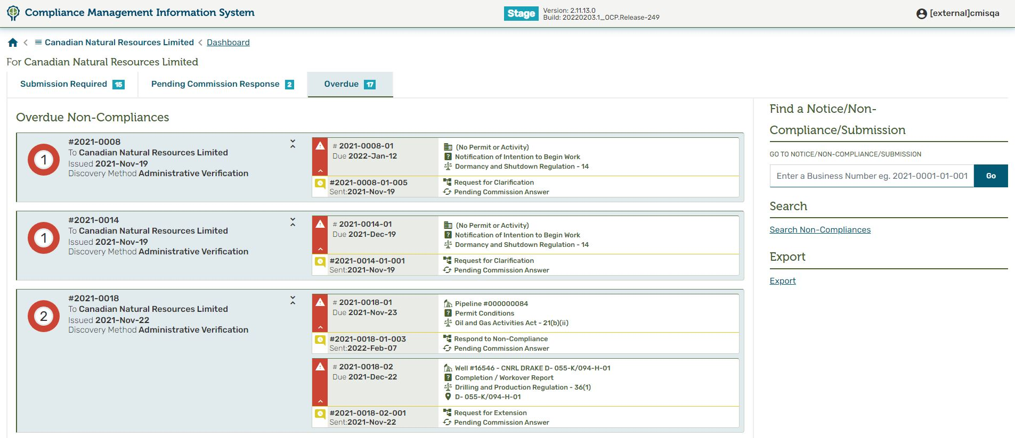
Using the Dashboard
Notes:
Using the Dashboard
There are three dashboard lists, which display Non-Compliance Notices that have been sent to the Permit Holder and which currently have the status of “Issued.”

Slide 13
Non-Compliance Notice Information
Notes:
Non-Compliance Notice Information
The Non-Compliance Notice Number
The Permit Holder's Organization Name
The date the Non-Compliance Notice was issued to the Permit Holder
The method used by the Commission to discover the Non-Compliance

Slide 14
Non-Compliance Information
Notes:
Non-Compliance Information
Following the Non-Compliance Notice’s Number is the Non-Compliance Number, beginning with 01, and incrementing by one, if there are more than one Non-Compliance on the Non-Compliance Notice
The date the Non-Compliance must be addressed by
The Activity’s, Permit’s, or Special Project Order’s Business Identifier or the Name of the Permit Holder
The Reason attributed to the creation of the Non-Compliance
The Legislation that is being enforced
If available, the location of the identified Activity

Slide 15
Non-Compliance Submission Information
Notes:
Non-Compliance Submission Information
The Non-Compliance Submission includes information about a Non-Compliance Submission that the Permit Holder representative has requested from CM-IS, including the following:
Following the Non-Compliance Notice Number and the Non-Compliance Number, is the Non-Compliance Submission Number, beginning with 01, and incrementing by one, if there are more than one Submission for the Non-Compliance
The date the Non-Compliance Submission was submitted by the Permit Holder Representative
The type of Non-Compliance Submission
The Outcome of the Non-Compliance Submission
The presence of the paperclip icon indicates that one or more files are attached to the Non-Compliance Submission

Slide 16
Rondel
One or more Non-Compliances are Overdue (in red)
One or more Non-Compliances are due within the next 7 days (in orange)
One or more Non-Compliances are due in more than 7 days (grey)
One or more Non-Compliances are Complete (in green)
Notes:
The colour coded rondel situated to the left of the Non-Compliance Notice information displays the following information about the Non-Compliance Notice and its Non-Compliances.
The number in the centre of the rondel is the total number of Non-Compliances on the Non-Compliance Notice
The coloured ring represents the mix of Non-Compliance statuses. The colour codes are represented as follows:
One or more Non-Compliances are Overdue (in red)
One or more Non-Compliances are due within the next 7 days (in orange)
One or more Non-Compliances are due in more than 7 days (grey)
One or more Non-Compliances are Complete (in green)

Slide 17
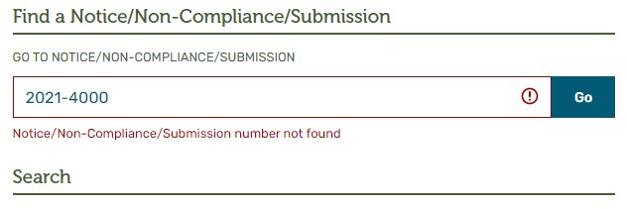
Searching for a Non-Compliance
Notes:
To find a specific Non-Compliance Notice, a Non-Compliance, or a Non-Compliance Submission, enter the corresponding number under the ‘Find a Notice/Non-Compliance/Submission’ banner.
To find a Non-Compliance Notice, enter its number, for example 2021-0001
To find a Non-Compliance, enter its number, for example 2021-0001-01
To find a Non-Compliance Submission, enter its number, for example 2021-0001-01-001
If the number cannot be found, an error message will appear:

Slide 18
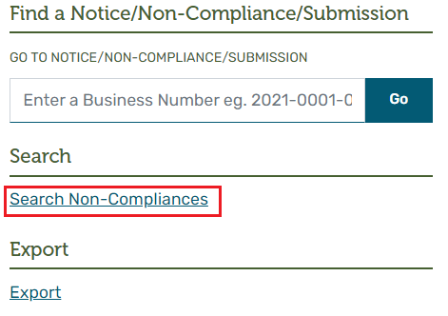
Non-Compliance Search Screen
Notes:
The Non-Compliance search screen is a searchable and sortable tabular list of Non-Compliances.
Access the Non-Compliance search screen from the Non-Compliance Dashboard, under the ‘Find a Notice/Non-Compliance/Submission’ banner, by selecting the ‘Search Non-Compliances’ link.

Slide 19
Non-Compliance Search Screen
Notes:
When opened, the Non-Compliance search screen will default to displaying information about Non-Compliances that have been 'Issued' to the currently selected Permit Holder (as selected when the user logged on or subsequently changed).
The Non-Compliance search screen presents rows of Non-Compliance information, with each row containing the following:
NC NUMBER:
LEGISLATION:
SECTION:
STATUS:
ACTIVITY TYPE:
ACTIVITY ID:
PERMIT NUMBER:
ASSIGNED TO:
DUE DATE:
RESPONSE:
OUTCOME:
The Non-Compliance search screen offers the flexibility to either find one specific Non-Compliance, or a group of Non-Compliances, depending on the selected search criteria. The default for the search screen is ‘The 'Issued' Non-Compliances, for the Organization I have selected.’
Each column of data on the search screen is equipped with a search icon. When selected, a search box will be displayed. Every column of information is represented by a unique type of search box, tailored for the information contained in that column. There are 3 types of search boxes:

Slide 20
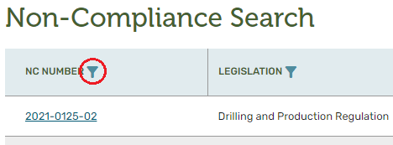
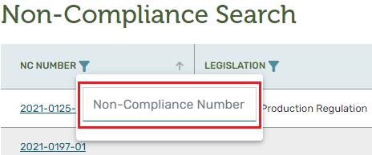
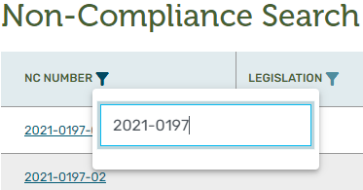
Non-Compliance Search Screen – Search Box
Notes:
Type-ahead Search Box
The type-ahead search box is used to either find a specific value, or groups of value, when only partial search information is known.
To search for a specific Non-Compliance, select the search icon, situated to the right of the column header.
Once the type-ahead search box opens, enter any numerical value that matches the Non-Compliance that is the target of the search.
The results of the search will be displayed. To remove the type-ahead search box, either click the search icon again, or click anywhere on the screen.

Slide 21
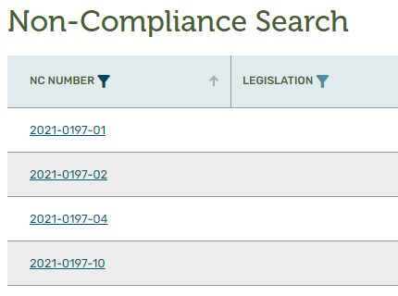
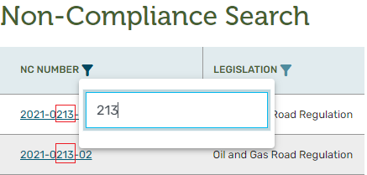
Non-Compliance Search Screen – Search Box
Notes:
To search for a group of Non-Compliances, select the filter icon, situated to the right of the NC NUMBER column, and once the type-ahead search box opens, enter any numerical value that matches the Non-Compliance that is the target of the search. The results of the search will be displayed.
To remove the type-ahead search box, either click the filter icon again, or click anywhere on the screen.
By clearing the value of a type-ahead search box, the affect will be like selecting all values within the list.

Slide 22
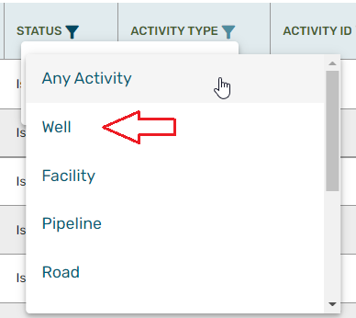
Non-Compliance Search Screen – Search Box
Notes:
Drop-Down List Search Box
The drop-down list search box is used when there is a limited list of values that can be selected.
To search for Non-Compliances that meet specific criteria, first start by selecting the search icon, situated to the right of the column header,
Select one of values presented in the drop-down list. The list of Non-Compliances will match with the selected value.
To activate the ACTIVITY ID filter, an ACTIVITY TYPE must be selected first.
To activate the SECTION filter, a LEGISLATION must be selected first.

Slide 23
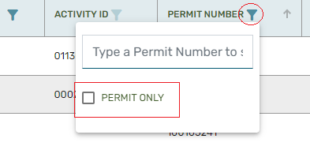
Non-Compliance Search Screen – Search Box
Notes:
Toggle (Checkbox) Search
The checkbox search box is a quick way to toggle on and off specific search parameters. There are four toggle searches.
Permit Only:
To toggle search functionality to view only Non-Compliances that are being enforced against a PERMIT, select the PERMIT ONLY checkbox from the PERMIT NUMBER column.
Requires Submission from Permit Holder Only:
To toggle search functionality to view only Non-Compliances that require the Permit Holder to create a Non-Compliance Submission, select the REQUIRES SUBMISSION FROM PERMIT HOLDER ONLY checkbox from the RESPONSE column.
Overdue Only:
To toggle search functionality to view only Non-Compliances that are currently overdue, select the OVERDUE ONLY checkbox from the DUE DATE column.

Slide 24
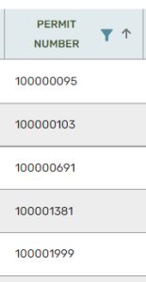
Non-Compliance Search Screen – Sort
Notes:
Sort Features
Each of the columns in the Non-Compliance search screen can be sorted, either ascending (lowest to highest), or descending (highest to lowest), based on the values that are currently in the column. The default sort order is ascending.
There are two options to sort of any column: Sort using the sort icon, or sort using the column header.
Sort by Sort Icon
Sort by clicking the sort icon , which is located at the far right of the column header. In the example below, the PERMIT column is being sorted, in ascending order.
Sort by Column Header
Columns of data can also be sorted by clicking the column header. Notice that when clicking the column header, the sort icon will change direction, indicating if the sort is ascending, or descending.

Slide 25
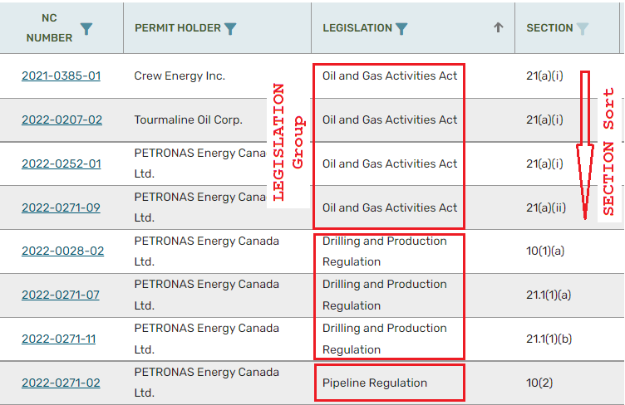
Non-Compliance Search Screen – Sort
Notes:
LEGISLATION and SECTION Sorting
When sorting by the LEGISLATION or SECTION, the display will group all SECTIONS with the same LEGISLATION together and sort the SECTIONS alphabetically within the LEGISLATION group. The LEGISLATION groups themselves are not sorted.

Slide 26
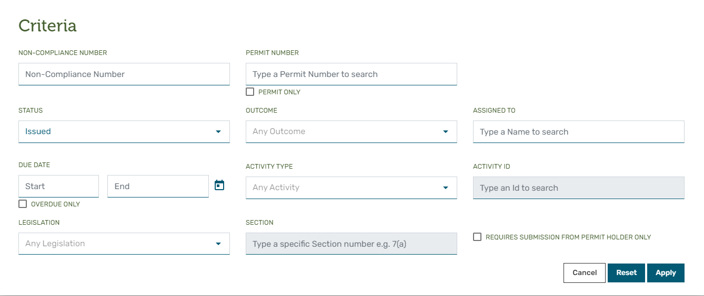
Search Criteria Menu
Notes:
The Criteria Menu is a single source collection of all searchable data elements for the Non-Compliance Search Screen.
Open the Criteria Menu by selecting the [CRITERIA] button from the Non-Compliance Search Screen.
Just like the Non-Compliance search screen, the Criteria Manu has the same set of data fields that can be used to change the search criteria.
To cancel the current operation, and close the menu, select the CANCEL button.
To reset the search parameters to the default settings (My 'Issued' Non-Compliances), select the RESET button.
To apply the current search parameters, after making selections, select the APPLY button.

Slide 27
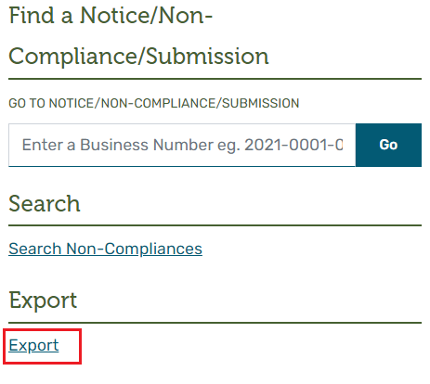
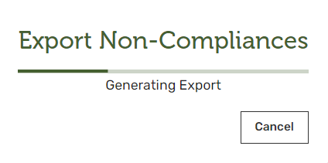
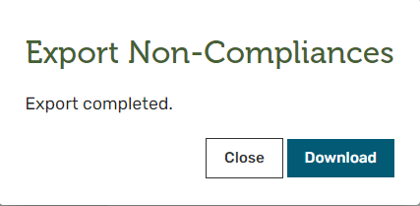
Exporting Non-Compliances
Notes:
Exporting All Non-Compliances for the Permit Holder
The Permit Holder can export a CSV file of all their Non-Compliances from the dashboard screen. The file will contain all the information available for the Non-Compliance Notice and individual Non-Compliances as seen on their details screens, except comments and the Notebook entries.
Clicking on the Export link will create the file. While CM-IS is composing the information, the user will see a dialogue progress box. The user can select the Cancel button if they wish to abandon the process, and not create the file, or wait until the process completes.
The user can select Download to allow the browser to download the export file or Close to exit without getting a copy of the file.

Slide 28
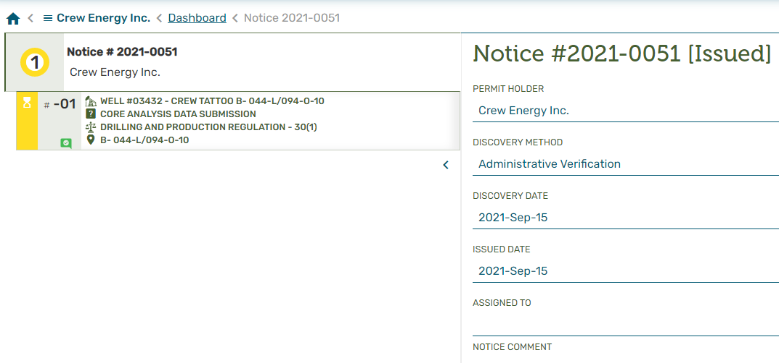
Working with Non-Compliance Notice
Notes:
Working with the Non-Compliance Notice
Viewing Non-Compliance Notice Details
To view the details of the Non-Compliance Notice, select the Non-Compliance Notice panel from the CM-IS Dashboard.
After clicking on the Non-Compliance Notice panel, the details of the selected Non-Compliance Notice will be displayed.
Non-Compliance Notice details include:
The Non-Compliance Notice Number
The name of the Permit Holder that the Non-Compliance is issued to
The date the Non-Compliance Notice was issued to the Permit Holder
The method by which the Non-Compliance was discovered
The name of the (‘ASSIGNED TO’) person at the Commission who issued the Notice
Comments the Commission have entered
A list of the individual Non-Compliances included on the Notice

Slide 29
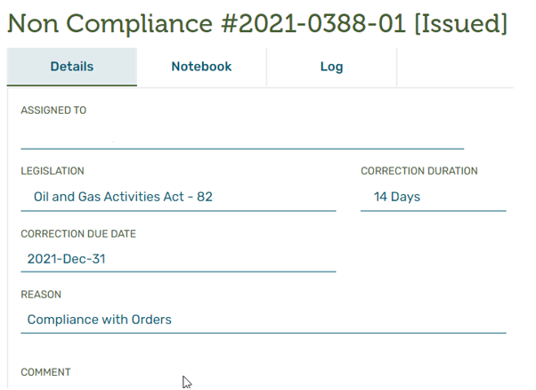
Viewing Non-Compliance Details
Notes:
Viewing Non-Compliance Details
To view the details of a Non-Compliance, select the Non-Compliance panel from the CM-IS Dashboard.
After clicking on the Non-Compliance from the panel, the details of the selected Non-Compliance will be displayed.
Non-Compliance details include:
The Non-Compliance Number
The name of the (‘ASSIGNED TO) person at the Commission who issued the Non-Compliance
The date that the correction of the Non-Compliance is due
The number of days before the Non-Compliance must be corrected
The status of the Non-Compliance
The legislation being enforced
The Activity, Permit, Special Project Order, or Permit Holder that has been identified as being in Non-Compliance
When an Activity, the Permit Number that the Activity was permitted under
Any comments that the Commission entered at the time the Non-Compliance was issued

Slide 30
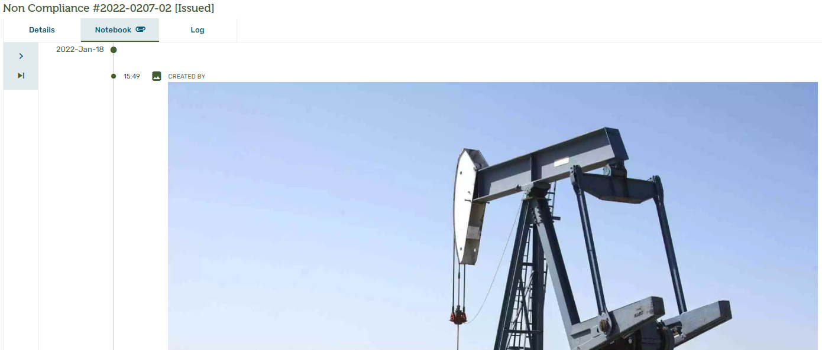
Viewing Non-Compliance Notebook
Notes:
Viewing the Non-Compliance Notebook
The Commission can provide additional documentation in the form of images, emails, and annotations on a Non-Compliance Notebook to help explain the reason why the Non-Compliance was Issued. There is a paperclip displayed on the Notebook tab of the Non-Compliance when additional information is available to view.

Slide 31
Viewing Non-Compliance Log
Notes:
Viewing the Non-Compliance Log
The Non-Compliance Log displays a history of all actions and events against the Non-Compliance in chronological order. The items that will show up on the history are:
All CM-IS letters and notification emails about the Non-Compliance Notice or the Non-Compliance sent to the Permit Holder.
All Notebook entries on the Non-Compliance
All Status changes of the Non-Compliance
All Commission Assignment changes to the Non-Compliance
The Permit Holder can download any items with the DOWNLOAD symbol.

Slide 32
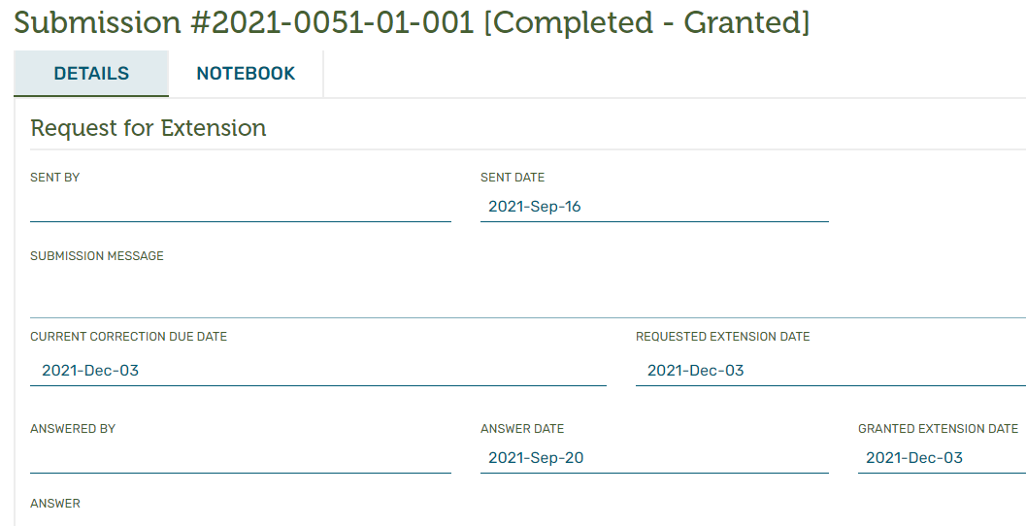
Viewing Non-Compliance Submission Details
Notes:
Viewing Non-Compliance Submission Details
Click within the Non-Compliance Submission panel to see details about the Non-Compliance Submission.
After clicking on the Non-Compliance Submission on the panel, the details of the selected Non-Compliance Submission will be displayed.

Slide 33
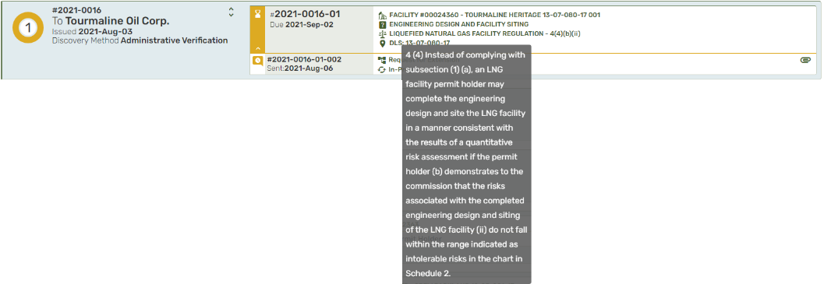
Viewing Legislation
Notes:
Viewing the Legislation
Hover over the Act or Regulation text to view the legislation that is being enforced for the Non-Compliance.

Slide 34
Viewing ‘Completed’ Non-Compliance
Notes:
Viewing a 'Completed' Non-Compliance
Once a Non-Compliance has been 'Completed', regardless of the Outcome of the Non-Compliance, the Non-Compliance will 'fall-off' the dashboard and will no longer be displayed.
However, the 'Completed' Non-Compliances are still visible, when viewing the Non-Compliance Notice.

Slide 35
Creating Non-Compliance Submission
Notes:
Creating a Non-Compliance Submission
There are three types of Non-Compliance Submissions available to Permit Holder representatives, which facilitate communicating with the Commission regarding individual Non-Compliances.
Use the 'Request for Clarification' to ask questions of the Commission regarding the content of the Non-Compliance
Use the 'Respond to Non-Compliance' to resolve the Non-Compliance.
Use the 'Request for Extension' to ask the Commission for additional time to address the Non-Compliance.
Access the Non-Compliance Submission options by clicking on the Non-Compliance, from the Non-Compliance Notices dashboard, or from the Non-Compliance from within the Non-Compliance Notice screen.

Slide 36
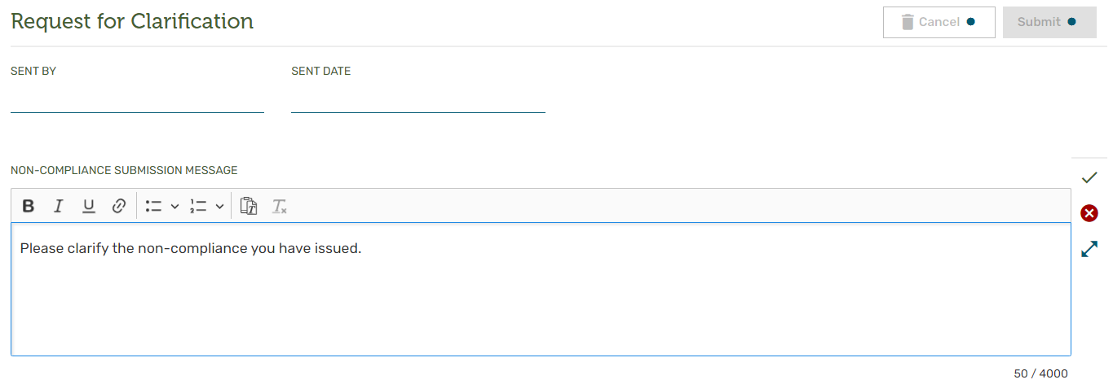
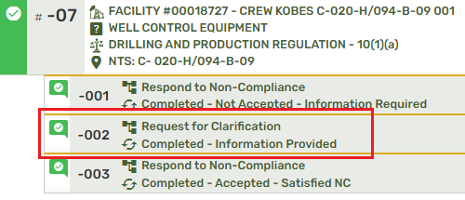
Request for Clarification
Notes:
Request for Clarification
Add information to support the 'Request for Clarification' into the Non-Compliance Submission Message field.
Save the contents of the message by selecting the checkmark icon, then select the 'Submit Request' button.
Once the Commission receives the 'Request for Clarification', they will provide 'Provide Information' in the way of a Submission answer. Once the Commission has sent the answer back to the Permit Holder, the Non-Compliance Submission will appear - Click on the Submission to read the answer that the Commission has provided.

Slide 37
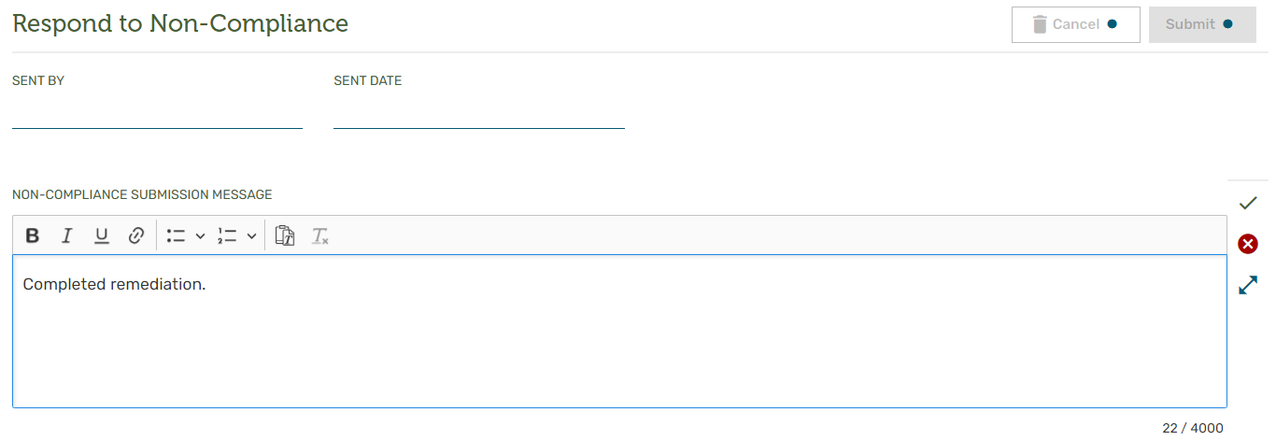
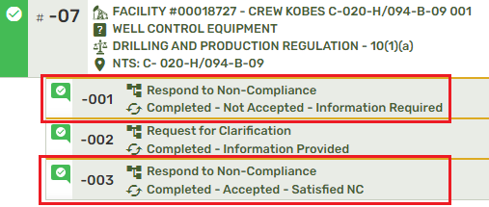
Respond to Non-Compliance
Notes:
Respond to Non-Compliance
Add information to support the 'Respond to Non-Compliance' into the Non-Compliance Submission Message field.
Once the Commission receives the 'Respond to Non-Compliance', they will provide a Non-Compliance Submission answer, along with one of the following responses:
Once the Commission has replied to the Permit Holder, using one of the above responses, the Non-Compliance Submission will appear as follows:
Optionally, the Commission may also decide that the Non-Compliance is no longer required and therefore may 'retract' the Non-Compliance. If the Commission 'retracts' a Non-Compliance, the Non-Compliance Submission will appear as follows:
Click on the Non-Compliance Submission to read the answer that the Commission has provided.

Slide 38
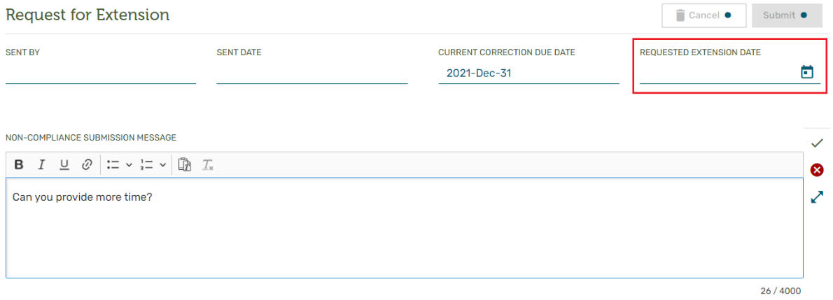
Request for Extension
Notes:
Request for Extension
Add information to support the 'Request for Extension' into the Non-Compliance Submission Message field.
Select a date from the Requested Extension Date.
Once the Commission receives the 'Request for Extension', they will provide a Non-Compliance Submission answer, along with one of the following responses:
Once the Commission has replied to the Permit Holder, using one of the above responses, the Non-Compliance Submission will appear as follows:
Click on the Non-Compliance Submission to read the answer that the Commission has provided.
The maximum number of characters that can be entered into the submission message field is 4000. If exceeded, the character counter will turn red, and the error message ‘The maximum length has been reached, please enter a shorter value’ will be displayed.

Slide 39
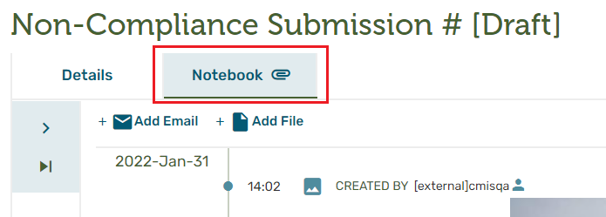
Notebook Attachments
Notes:
Managing Attachments on a Non-Compliance Submission Notebook
Files and emails can be added to the Non-Compliance Submission Notebook to support the Submission while it is in Draft Status.
From the Notebook tab on any Draft Non-Compliance Submission, select ‘Add file’, or ‘Add email’ to add any of the types of files listed below:
The following file types can be attached to a Non-Compliance Submission:
Microsoft Word Documents .doc, .docx
Microsoft Excel Documents .xls, .xlsx, .csv, .xlsm
Microsoft Power Point Documents .ppt, .pptx
Text Documents .txt, .rtf, .csv
Video Documents .avi, .mov, .m4v, .svi, .wmv, .mp4, .mpg, .mpeg, .mkv
Picture Documents .gif, .bmp, .jpg, .jpeg, .png, .svg, .tif
Portable Document Files .pdf
Archive Files .zip
The following Email types can be attached to a Non-Compliance Submission:
.msg
.eml
After selecting ‘Add File’, or ‘Add Email’, files can be attached to the SNon-Compliance Submission using one of the following methods:
Drag & Drop
Browse
The maximum file size that can be uploaded to the application is 450 Mb. However, depending on network, or internet conditions, the ability to upload a file of this size may be compromised. Errors or warnings may occur if the file size exceeds these limits.

Slide 40
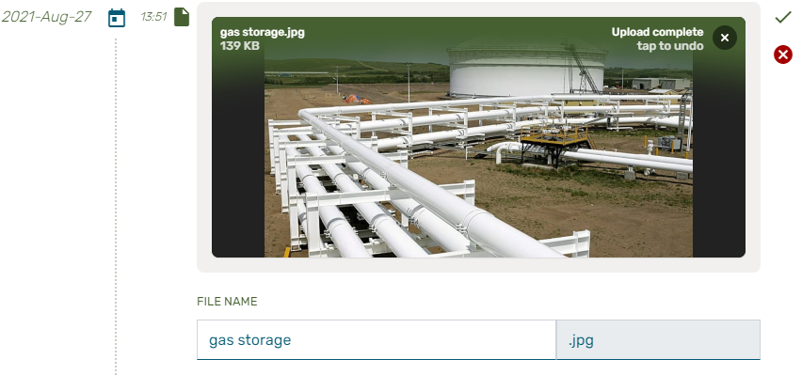
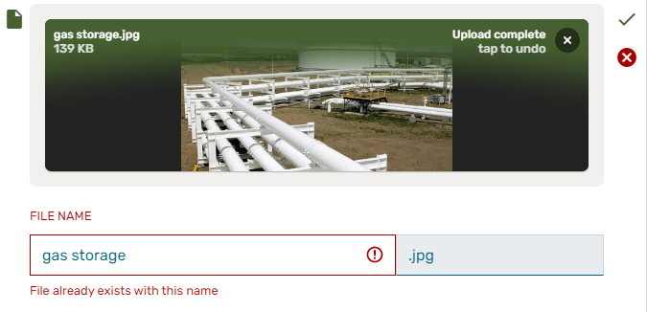
Notebook Attachments – Drag & Drop
Notes:
Adding a File
Drag & Drop Method
To use the drag & drop method for attaching a file to a Non-Compliance Submission, open Window Explorer and navigate to the location of the file that will be attached to the Non-Compliance Submission.
Select the required file and drag, then drop in the area marked as ‘DROP FILE HERE OR CLICK TO BROWSE’
When the ‘Upload Complete’ message is displayed, select the checkmark to save, optionally change the name of the file, or select the red 'X' to cancel.
If a file already exists with the same file name, the system will provide the following warning ‘File already exists with this name’

Slide 41
Notebook Attachments – Browse
Notes:
Browse Method
To use the browse method for attaching a file to a Non-Compliance Submission, click on the file landing spot (DROP FILE HERE OR CLICK TO BROWSE), Windows Explorer window will open.
With Windows Explorer open, select the required file, and click open to begin the process.
When the ‘Upload Complete’ message is displayed, select the checkmark to save, optionally change the name of the file, or select the red 'X' to cancel.

Slide 42
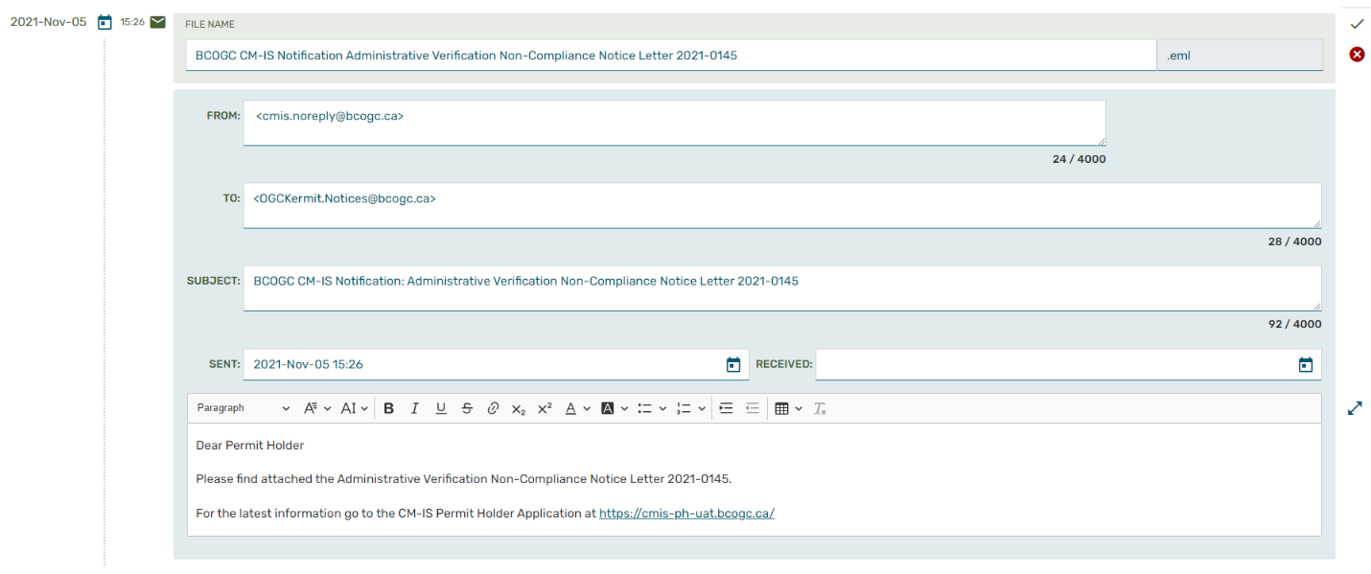
Notebook Attachments – Email
Notes:
Adding an Email
After using either the Drag & Drop, or the Windows Explorer method of adding an Email to the Non-Compliance Submission Notebook, it is possible to modify the email information taken directly from the email file, including the following:
File Name
From
To
Subject
Sent
Received
Body of the email
Select the checkmark to save, optionally change the email information, or select the red 'X' to cancel.

Slide 43
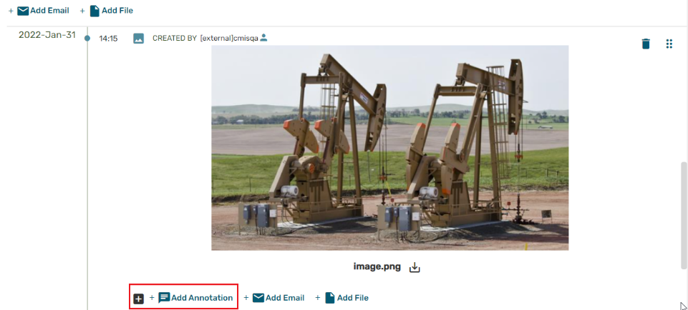
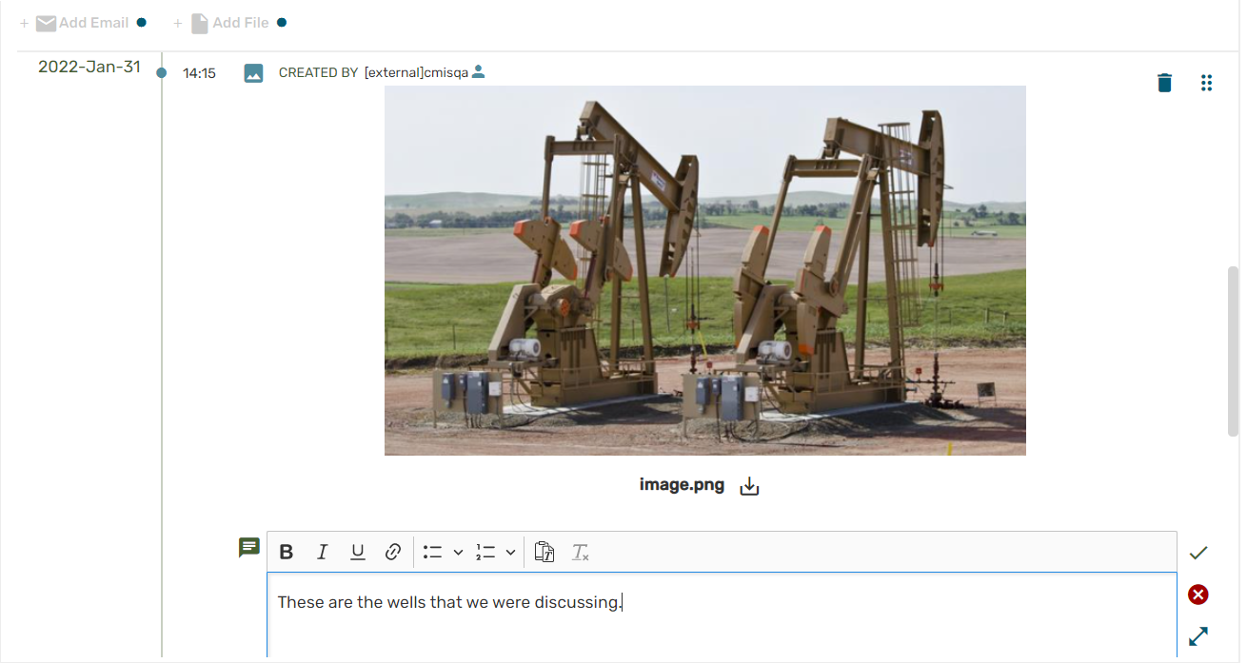
Notebook Attachments – Annotations
Notes:
Annotating Files and Emails
When adding either a file, or an email to a Non-Compliance Submission, the file or email can be further described by adding annotation. Hover over the '+' symbol, then select 'Add Annotation’
The content of the annotation can be up to 4000 characters in length, and can include rich-text formatting such as:
Bolding
Italics
Underling
Bullets
Numbering
Click the checkmark to save the annotation, or the red 'X' to cancel.

Slide 44
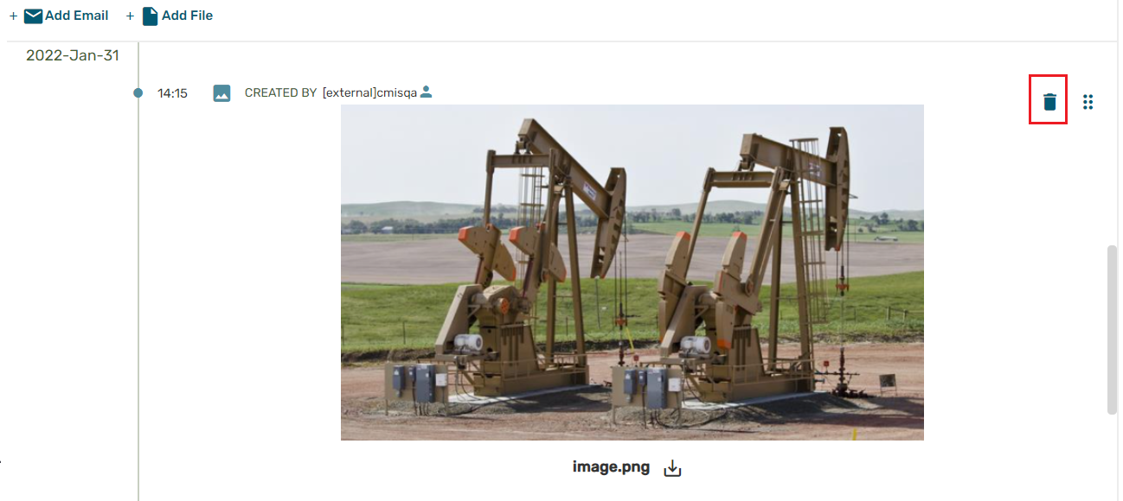
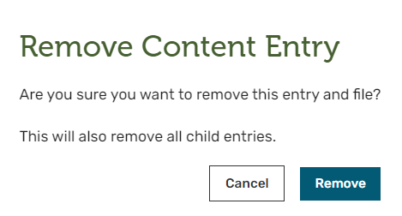
Notebook Attachments – Deletion
Notes:
Deleting a File or Email
Files and emails that have been attached to a Non-Compliance Submission while in Draft Status can be deleted before you send the Non-Compliance Submission.
Select the trashcan icon located at the top right corner of the Non-Compliance Submission Notebook entry.
Select Remove button to delete the image from the Non-Compliance Submission Notebook or
Cancel button to remove it from the Non-Compliance Submission Notebook.

Slide 45
Notebook Attachment – Moving Entries
Notes:
Moving a Non-Compliance Submission Notebook Entry
You can reorder entries in the Non-Compliance Submission Notebook by selecting the icon located at the top right corner of the Non-Compliance Submission Notebook entry with the mouse and dragging it to the location that you want to reside.

Slide 46
Submitting Non-Compliance Submission
Notes:
Submitting a Non-Compliance Submission
Once the required information for the Non-Compliance Submission is provided, submit the request to the Commission.
The Non-Compliance Submission will now have a Status of ‘Pending Commission Answer’, waiting for an answer from the Commission.
Returning to the dashboard, the Non-Compliance Submission will appear in the Non-Compliance Submission panel of the Non-Compliance.

Slide 47
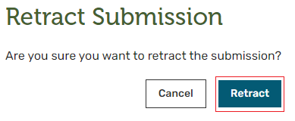
Retracting Non-Compliance Submission
Notes:
Retract a Non-Compliance Submission
At any time after a Non-Compliance Submission has been made to Commission, but prior to the Commission's response, the Non-Compliance Submission can be retracted.
To retract a Non-Compliance Submission, navigate to the Non-Compliance Submission, and select the RETRACT SUBMISSION button
Complete the retraction when prompted or cancel.
Once confirmed, the Non-Compliance Submission will be identified as 'Completed – Retracted'. Any information associated with the Non-Compliance Submission will still be viewable, but not changeable. The Commission will also be able to view the information associated with the Non-Compliance Submission.

Slide 48
FACEBOOK
TWITTER
Thank you.
Questions?
LINKEDIN
INSTAGRAM
YOUTUBE
Notes:
If you’re done adding content to your slides, don’t forget to:
Take a break! Come back to it with fresh eyes before editing.
Practice presenting to a colleague for constructive criticism and insights.
Visit the full PowerPoint Toolkit at ‘K:\Commission Shared\PowerPoint Toolkit’ to learn how to edit and refine your slides, and to view the video providing tips on how to best present to your audience.

